Slide 1

Decision Tree
AJAY KUMAR

Slide 3
What is Decision Tree?
Decision Tree is a non-parametric supervised learning method used for Classification and Regression
The goal is to create a model that predicts the value of a target variable by learning simple decision rules inferred from the data features
Decision tree learns from data to approximate the target function with a set of if-the-else decision rules

Slide 4


How Decision Tree [CART] Algorithm Works ?
Goal : To predict type of fruit given shape and size of fruit
Information Gain = 0.37
Gini Impurity= 0
Is diameter >=3?
Data
R 1 Cherry
Y 3 Apple
R 2 Cherry
Y 3 Lemon
Gini Impurity= 0.44
False
True
R 3 Apple
Color
Diameter
Label
Is color == Yellow ?
Green
3
Apple
Yellow
3
Apple
Information Gain = 0.17
Predicted
Cherry 100%
R 3 Apple
Y 3 Lemon
Red
1
Cherry
False
True
Y 3 Apple
Red
2
Cherry
Yellow
3
Lemon
Predicted
Apple 100%
Predicted
Apple 50%
Lemon 50%
Which feature to choose for Root Node and subsequent Node?
How is the Decision at each Node made?

Slide 5
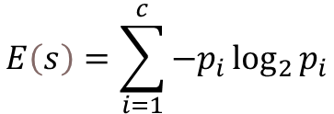
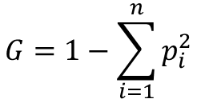
What is Information Gain and Gini Impurity
Information Gain
Gini Impurity
  Entropy is the main concept of this algorithm, which helps to determine a feature or attribute that give maximum information about a class is called Information gain
  Mathematical Formula
  First IG is calculated for all features and the one with highest IG is selected as root Node
  The measure of the degree of probability of a particular variable being wrongly classified when it is randomly chosen is called Gini Impurity
  Mathematical Formula
Feature 1 = 0.10
Feature 2 = 0.37
.
.
Feature n = 0.25
Root node of Tree

Slide 6
When to use Decision Tree?
Pros
Cons
DT are great for regression and classification problems when features are numerical
One of the biggest advantage of using DT is that they are interpretable, the tree can be visualized
DT has the ability to handle multiple outputs
Susceptible to overfitting
Decision Tree is an NP-Hard problem, hence heuristic algorithm such as the greedy algorithm where locally optimal decision are made at each node, such algorithm cannot guarantee to return the globally optimal decision
DT can create biased tree if some classes dominate, hence always ensure the dataset is balanced

